Slide 1
Corona sensor
:Team members
1- Alsherif Shaban Abdulmejed ( TEAM LEADER )
2- Almodather Ibrahim Hassan
3- Andrew Ezzat Daoud
4- Islam Ahmed Saif Salem
5- Andrew samir Bakieet Ghaly
6- Ayman Osama Syed

Slide 2
Project Idea
The Corona virus has crossed the whole world and the medical staff was the most vulnerable, so we came up with this device (corona sensor)
This device works to identify the Corona virus, and determine whether there are infections in a place, with an accuracy of up to 95 percent, in just 15 minutes.
This invention will greatly facilitate people's lives in light of the spread of the epidemic, and not only for hospitals to prevent it
The spread of "Covid-19".

Slide 3
The device relies on a CT scan of everyone inside the hospital room, thus identifying the affected person at 95 percent. The advantage of this device is that it warns everyone in the place with their eyes in case only one case is detected.
With the device placed in each room inside the hospital or in the required place, it can, within 15 minutes, detect the Corona virus and notify the attendees of the presence of an infected person among them, after which the usual examinations are performed to determine whether the patient is infected or not.
General statement:

Slide 4
Time taken
November: We will make the necessary algorithms and flowcharts for the program
February: We will manufacture the necessary hardware and software for the device.
March: We will test the device and correct errors, if any.
April: We deliver the device to hospitals for use.

Slide 5
General statement
Team1 : They will manufacture the hardware for the device.
Team2 : They will collect information about the symptoms of the corona virus.
Team3 : They will program the software for device.
Team4 : They supervise the project and make sure that it will be delivered on time.

Slide 6
project resource
We need 60000 dollars as a budget for the device
We need it for :-
1- The materials from which it is made
2 - Giving salaries to project workers
3 - making ads for the device

Slide 7
High level risks
The device does not recognize the person infected with the virus by 100%

Slide 8
Project Exclusions
• The device does not give the necessary treatment. • The device does not perform the necessary tests and
analyzes. • The device does not prevent infection. • The device does not detect other viruses. • The device does not identify the injured from a distance of more than 10 meters. • The device does not know how strongly you are affected by the virus. • The device will not have a way to chat or connect with any doctors. • .The device does not recognize if you have diseases similar to the Corona virus

Slide 9
Project Constraints
1- We have done a detailed work to determine the budget required to complete this project, and we have found that it is 60,000 dollars
2- After several studies that we carried out to determine the deadline for this project, taking into account the addition of additional time in anticipation of circumstances, we found that the date will be the month of April.

Slide 10
Work Breakdown Structure ( WBS )
(let’s pretend it’s been assigned a project code of 507 in your organization). 507.1 Database
507.2 Network
507.3 software
507.4 Hardware
* 507.1 Database
> 507.1.1 old information about corona virus
> 507.1.2 new information about the virus is changing rapidly
* 507.2 Network
> 507.2.1 Router
+ 507.2.1.1 huge cables
+ 507.2.1.2 Server
+ 507.2.1.3 WIFI

Slide 11
> 507.2.2 Switch
> 507.2.3 WAN
+ 507.2.3.1 LAN
- 507.2.3.1.1 many computers
- 507.2.3.1.2 cables
*507.3 software
> 507.3.1 programmers
> 507.3.2 A program that performs CT scans for each person
+ 507.3.2.1 Mechanism to determine whether a person is infected or not
> 507.3.3 A program that determines the number of infected people in the hospital room
* 507.4 Hardware
> 507.4.1 engineers
> 507.4.2 Metal
> 507.4.3 electronic board
> 507.4.4 glass
>507.4.5 electrical wires and cables

Slide 12
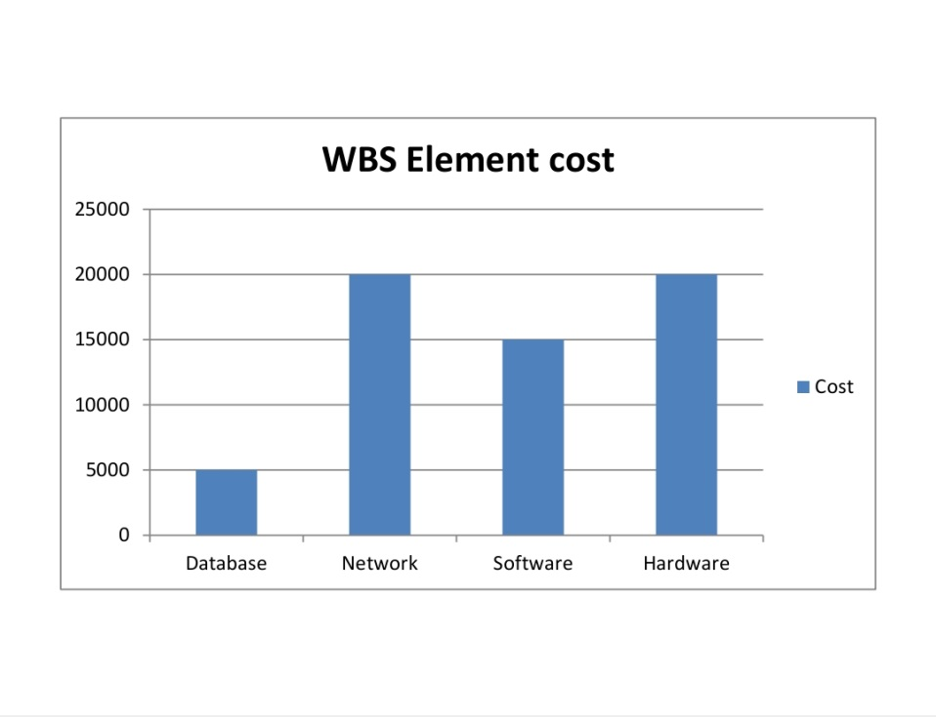
Cost to create the WBS element

Slide 13
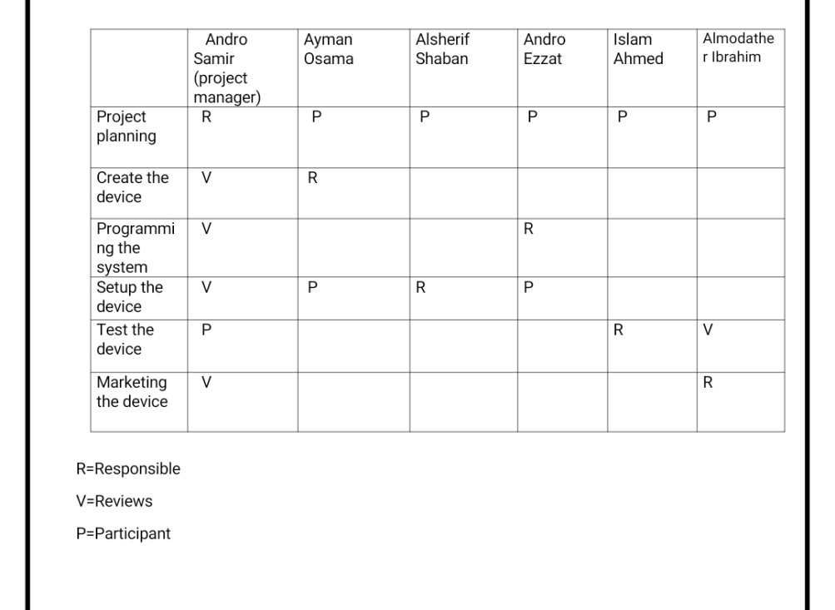
Responsibility Matrix

Slide 14
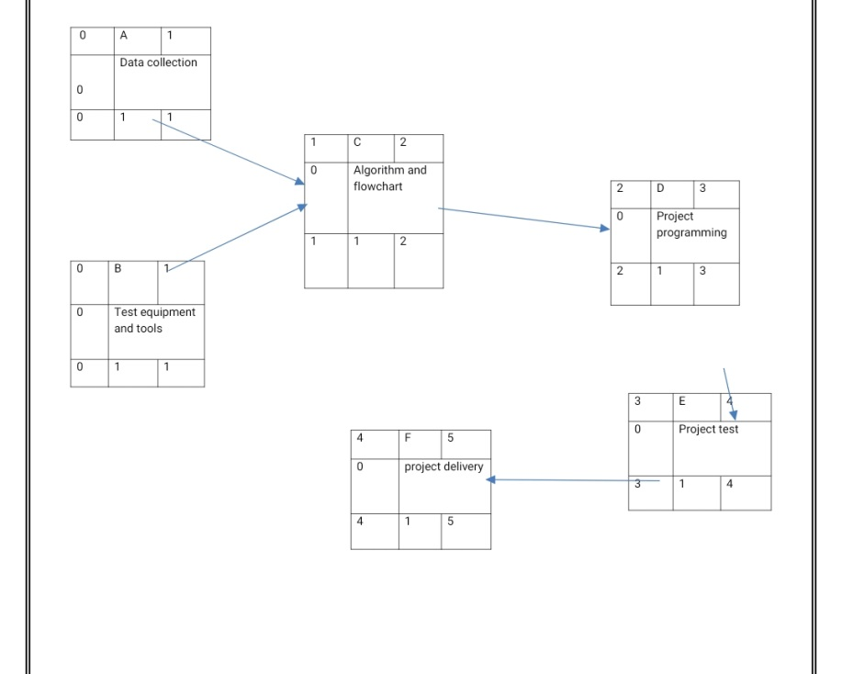
Project Network

Slide 15
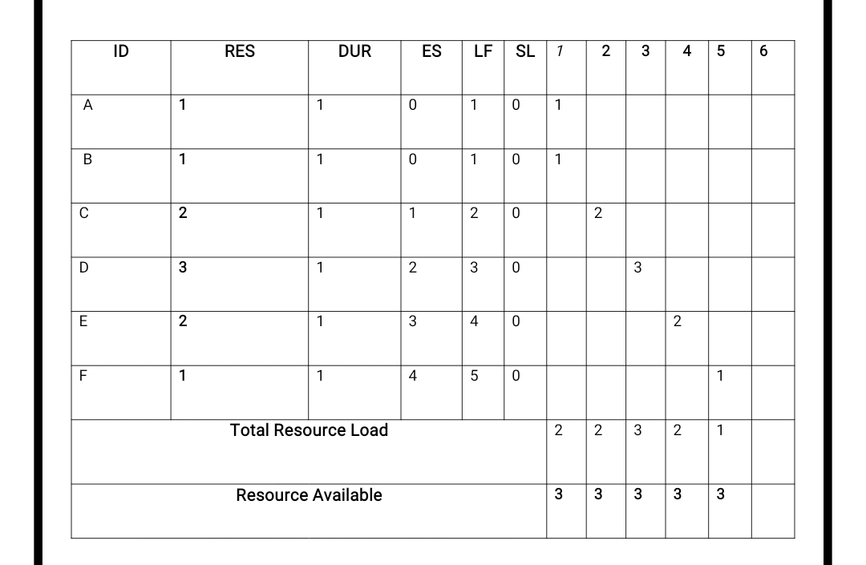
RESOURCE

Slide 16
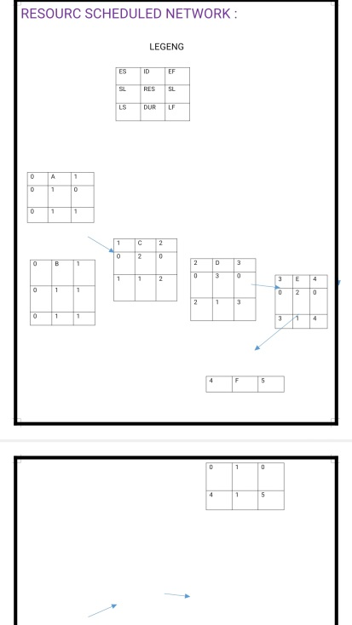

Slide 17
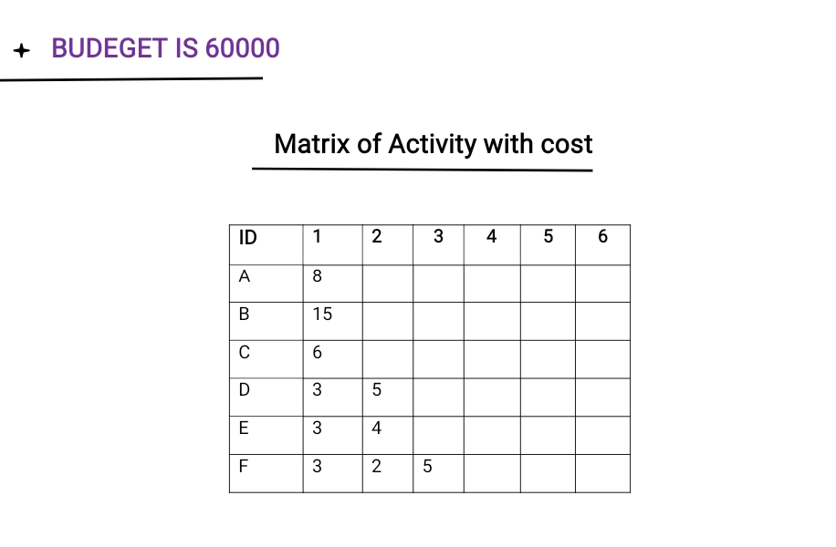
BUDGET BASLINE

Slide 18
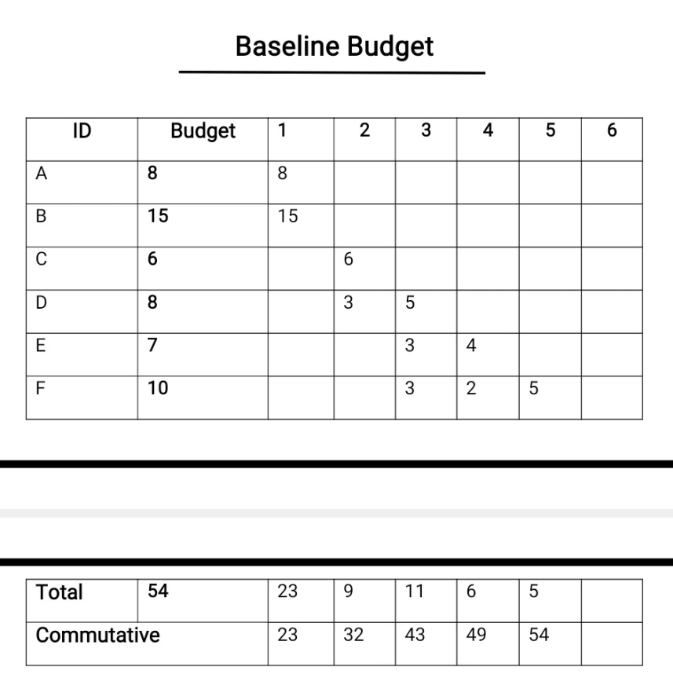

Slide 19
RISK AND MONITORING
Risk
1- The device does not recognize the person infected with the virus by 100%
2- The device malfunctions after exposure to an increase in the load, meaning that the device will be exposed to a large number of people beyond its capacity to absorb it at once. In this case, the device will give wrong results or the device will stop
3- Exposure of the device to external factors, which leads to a decrease in its life span or to give wrong results

Slide 20
Monitoring
It includes several areas in the project environment
1-Measurement: identifying regression through formal and informal reporting
2-Evaluation: It is intended to identify a deviation from a plan
3-Correction: It is taking measures to correct deviations

